Slide 1
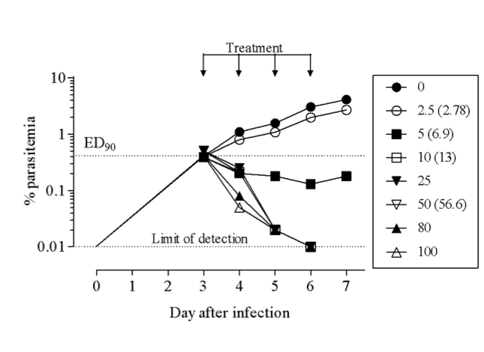
A
B
OSM-S-218
R¹ = OCH₃, R² = CN
Pf EC₅₀ = 0.040 µM
OSM-S-272
R¹ = H, R² =Cl
Pf EC₅₀ = 0.091 µM
OSM-S-377
R¹ = OCF₂H, R² = CN
Pf EC₅₀ = 0.017 µM

